Slide 1

Phase-III The Topic Mindmap Research on Chest X-rays to deduct various respiratory infections
Guided by: Dr. Sabah Mohammed
Mohan Prasad Kutala
mkutala@lakeheadu.ca

Slide 2
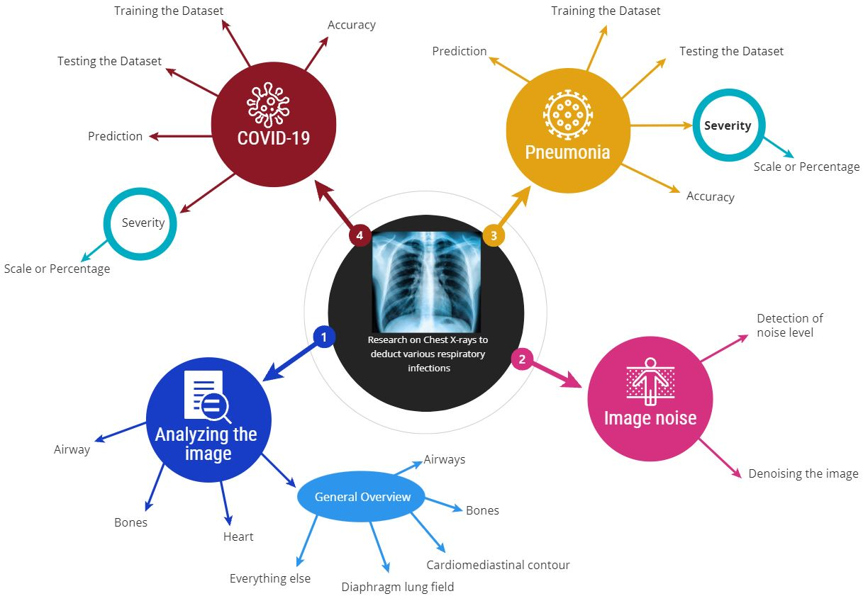
The Topic Mindmap

Slide 3
Analyzing the Image
* identification of other tissues,
normally Air appears black,
fat appears gray,
soft tissues and water appear as lighter shades of gray,
bone and metal appear white.
The denser the tissue, the whiter it will appear on x-ray.
Using A, B, C, D, E is a helpful and systematic method for chest x-ray
A: airways
B: breathing (the lungs and pleural spaces)
C: circulation (cardiomediastinal contour)
D: disability (bones - especially fractures)
E: everything else, e.g. pneumoperitoneum

Slide 4
Image noise
The common types of noise that are present in x-ray images are
Poisson noise
salt and pepper noise
speckle noise.
We have different types of techniques to remove the noise inside the image such as
Mean filter
Gaussian Filter
Median Filter (Highly recommended filter to remove Salt and pepper noise)
Other Filters

Slide 5
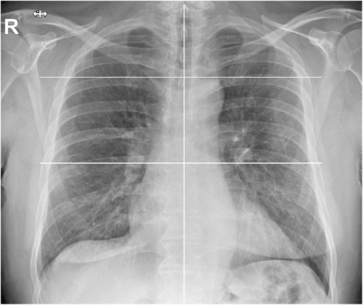
Covid-19 & Pneumonia
Training the Dataset
Testing the Dataset
Accuracy and Prediction
Severity
subdividing each lung into three zones
upper zone (from the lung apex to the aortic arch profile),
middle zone (from the aortic arch profile to the lower margin of the left pulmonary hilum)
lower zone (from the lower margin of the left pulmonary hilum to the diaphragm).
scale from zero to three
0 → normal or initial stage
2 → presence of radiopacity for less than 50%
3 → 50% damage
4 → more than 50% damage

Slide 6


